Slide 1
Solar Energy
Solar energy is light energy.
Solar energy is renewable.

Slide 2
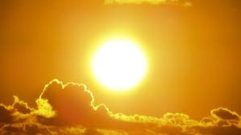
Solar Energy
We get most of our energy from the sun. We call it solar energy. It travels from the sun to the Earth in waves or rays. Some are light rays that we can see. Some rays we cannot see, like x-rays. The sun is a star. It is a giant ball of gas. It sends out huge amounts of energy every day. Most of the energy goes off into space. Only a small part reaches the Earth.
We use solar energy in many ways. All day, we use sunlight to see what we’re doing and where we’re going. Sunlight turns into heat when it hits things. Without the sun, we couldn’t live on the Earth—it would be too cold. We use the sun’s energy to heat water and dry clothes.

Slide 3
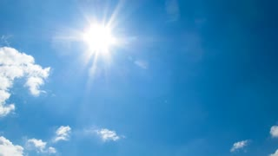
Solar Energy
Plants use the light from the sun to grow. Plants take the energy in light and store it in their roots, stems, fruits, and leaves. That energy feeds every living thing on Earth. We can also burn plants to make heat.
The energy from the sun makes rain fall and wind blow. We can capture that energy with dams and windmills. Coal, oil, and natural gas were made from prehistoric plants and animals. The energy in them came from the sun. We use that energy to cook our food, warm our houses, run our cars, and make electricity.

Slide 4
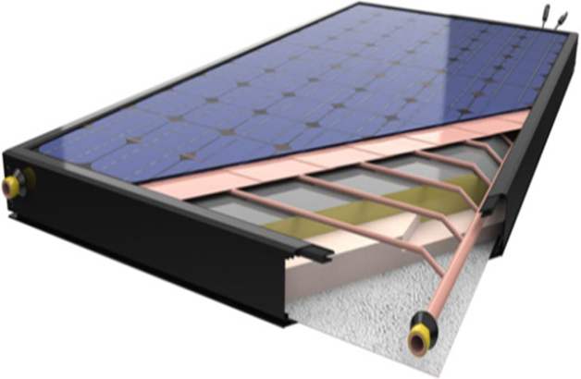
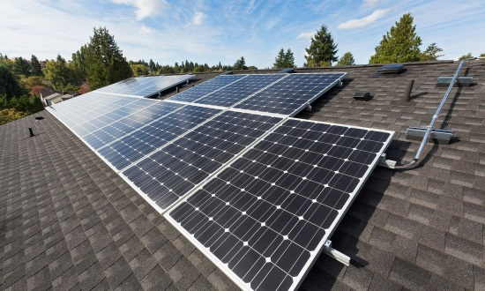
Solar energy is free and clean. There is enough for everyone and we will never run out of it. Solar energy is renewable. The sun will keep making energy for millions of years. Why do we not use the sun for all our energy needs? We do not know how to yet. The hard part is capturing the sunlight. It shines all over the Earth and only a little bit reaches any one place. On a cloudy day, most of the light never reaches the ground at all.
Lots of people put solar collectors on their roofs. Solar collectors capture the sunlight and turn it into heat. People heat their houses and their water using the sun’s energy.
Solar cells can turn light energy into electricity. Some toys and calculators use solar cells instead of batteries. Big solar cells can make enough electricity for a house. They are expensive, but good for houses far away from power lines.
Today, solar energy provides only a tiny bit of the electricity we use. In the future, it could be a major source of energy. Scientists are looking for new ways to capture and use solar energy.

Slide 5
Soo Lee and Mandy tip-toed out of their tent. It was so early; the sun was just beginning to peek over the mountain behind them.
They sneaked over to the boys’ tent and slipped a paper bag inside. Then they ran all the way to the lake and hid behind the big rock. They laughed and laughed.
A few minutes later, they heard screaming from the boys’ tent. Carlos and Jeremy came flying out in their underwear, flapping their arms and yelling.
“Help! Help! Something’s crawling all over me!” “Jake, get these bugs bugs off of me! Yeow!”
The boys ran straight into the lake and dove under the water.
When their heads popped back up, they saw Soo Lee and Mandy standing on the shore, laughing.
Soo Lee yelled, “What’s the matter, boys? Got ants in your pants?” “That’ll teach you to put frogs in our sleeping bags!” added Mandy.
A little while later, they were all back at camp, eating a big breakfast of hotcakes and sausage. Jake, the boys’ counselor, said, “No more practical jokes, ladies and gentlemen.” And Ellen, the girls’ counselor, just shook her head and asked, “Where do you kids get all that energy?”
Where Do You Kids Get All That Energy?

Slide 6
After cleaning up, they packed a picnic lunch and headed for Lookout Mountain. It took them all morning to climb the steep, rocky path to the top.
While Jake and Ellen cut up fruit and made sandwiches, the kids explored the mountain top. They watched as an eagle swooped down to catch a field mouse caught out in the open.
After lunch, the counselors rested in the shade of the famous Lookout Tree.
“Let’s play King of the Mountain,” suggested Jeremy.
“You mean Queen of the Mountain, don’t you?” answered Mandy.
As the kids ran off, Ellen yelled after them, “Where do you kids get all that energy?”
After hiking back down the mountain, the whole group headed to the lake. The cool water felt so good. The counselors lost a ferocious water battle with the campers.
Carlos and Soo Lee grabbed fishing poles and walked to the pool where Lookout Creek emptied into the lake. It was their turn to catch dinner. Mandy and Jeremy took a bucket and went looking for blackberries.
After a delicious dinner, everyone sat on the big rock by the lake, watching the sun go down. “Let’s go for a moonlight canoe ride,” said Jeremy.
“Aren’t you kids tired yet?” said Jake. “You’ve sure worn me out today!”
“Where do you kids get all that energy?” asked Ellen, for the third time that day. Soo Lee sat up.

Slide 7
Soo Lee sat up. “Where do we get our energy, Ellen?” she asked.
Ellen pointed to the sun sinking into the horizon. “That’s where we get our energy—from the sun.”
“You mean we have to be out in the sun to get energy?”
“No, I don’t mean that. We get our energy from the food we eat. All the food we eat comes from plants—like wheat and corn, and fruits and vegetables. And the plants get their energy from the sun.”
“But, wait a minute! We ate sausage today—that comes from a pig,” said Carlos. “Yeah,” said Mandy. “And we ate fish for dinner. Fish aren’t plants.” You’re right,” said Jake. “But those pigs and fish got their energy from the plants they ate. And those plants got their energy from the sun.”
“Oh! I see,” said Carlos. “I ate the sausage that’s made from a pig. The pig ate corn, and the corn got its energy from the sun.”
“Let’s do a sun dance!” said Jeremy, jumping up and waving his arms at the setting sun. “You guys go ahead and I’ll watch. I’m too tired to dance,” said Ellen.
“Here, Ellen, eat these leaves,” laughed Mandy, as she handed a branch to the counselor. “You need some energy. You’d better eat the whole tree if you’re gonna try to keep up with us tomorrow!”

Slide 8
T h e T a l e o f J o h n n y E n e r g y S e e d
I’m Johnny Energy Seed. I plant energy seeds in a big field on my farm.
The sun shines. There is energy in the sun’s rays. It helps my seeds grow into tall plants. My plants store the sun’s energy in their roots, stalks, leaves, and ears. Soon my energy plants are tall and strong.
I can use the energy in my plants for many things. I can eat the seeds for energy for my body. This energy will help me grow and move and think.
I can feed my energy plants to my chickens, pigs, cows, and horses. The energy will make my animals grow big and strong.
I can hang my energy plants in my barn to dry. Then I can burn them in my fireplace. The energy in my plants can keep me warm on cold winter nights.
I can put my energy plants into a big container that keeps out the air. As my plants decay, they can make a gas that I can burn in my stove to cook my food.
I can also turn my energy plants into fuel for my tractor. I turn them into alcohol, like grapes are turned into wine. This alcohol fuel, called ethanol, can run my tractor.
As you can see, a seed of corn really is an energy seed. Why don’t you plant some corn seeds and explore the ways you can use the energy in the plants you grow?

Slide 9
Plants convert the sun's energy to food.
Solar energy makes plants grow.
©2015 The NEED Project 8408 Kao Circle, Manassas, VA 20110 1.800.875.5029 www.NEED.org
57

Slide 10
Solar energy heats land and water.
When solar energy comes in contact with an object it turns into heat.
58
Primary Energy Infobook

Slide 11
Some people hang clothes outside to dry.
We can use solar energy to dry our clothes.
©2015 The NEED Project 8408 Kao Circle, Manassas, VA 20110 1.800.875.5029 www.NEED.org
59

Slide 12
Solar panels are made of many solar cells. People put solar panels on their homes to turn solar energy into electricity.
Solar cells turn sunlight into electricity.
60
Primary Energy Infobook

Slide 13
Energy From the Sun
©2014 The NEED Project P.O. Box 10101, Manassas, VA 20108 1.800.875.5029 www.NEED.org
5

Slide 14
Food Has Energy
6
Primary Science of Energy

Slide 15
How Our Bodies Use Energy
Word Bank
breathing digesting food
feeling hearing
moving moving blood
seeing smelling
tasting thinking
4
Primary Science of Energy

